Slide 1
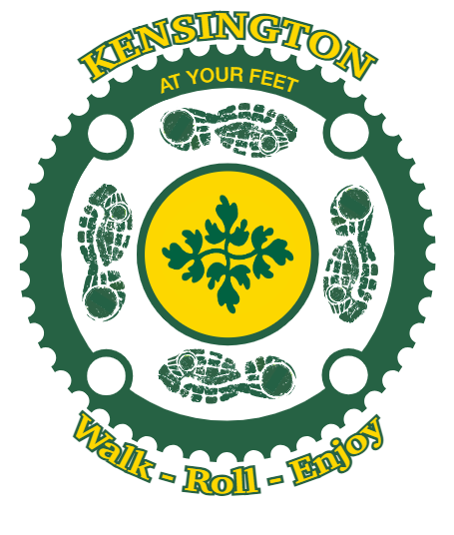
Pedestrian and Bicycling Access
and Safety Working Group
Public Art and Tactical Urbanism
Concept Preview

Slide 2
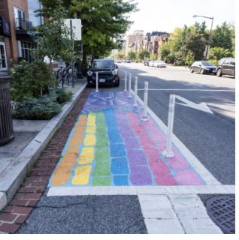
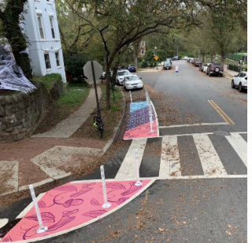
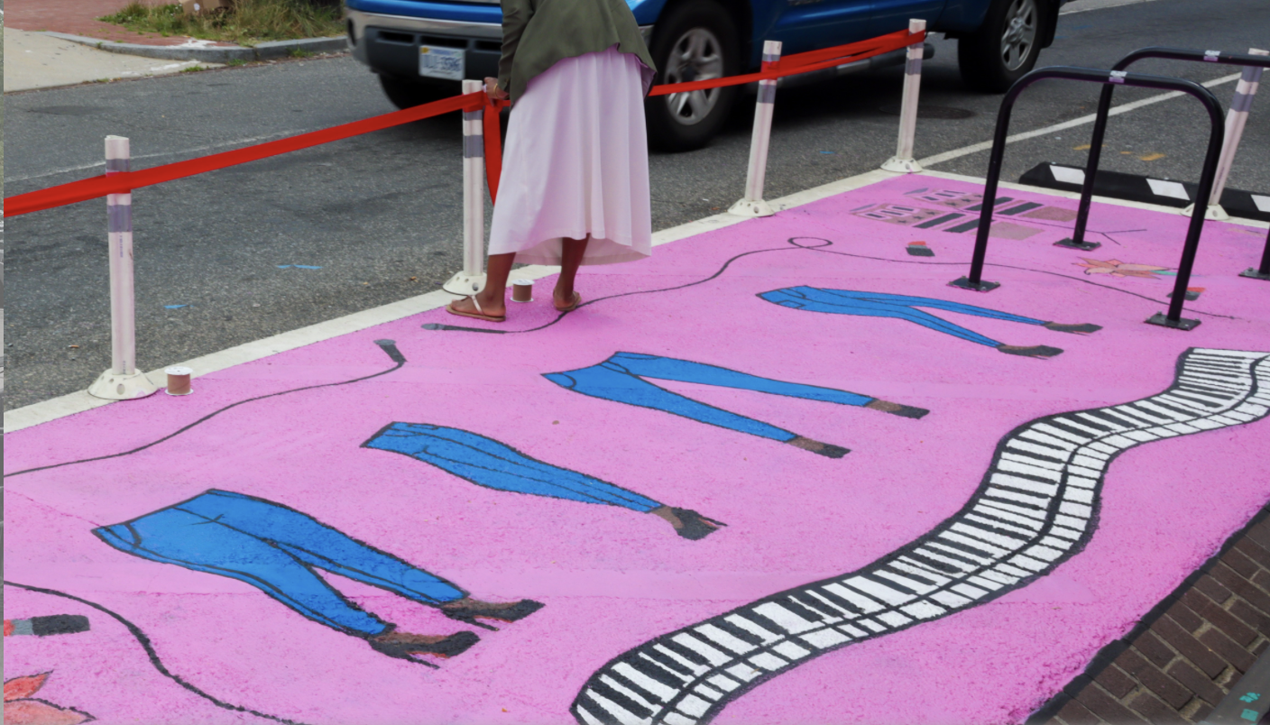
Agenda
Why Tactical Urbanism
Public Art and Tactical Urbanism
Candidate Sites
Next Steps

Slide 3
Why Tactical Urbanism?
Tactical Urbanism refers to a city, organizational, and/or citizen-led approach to neighborhood building using short-term, low-cost, and scalable interventions to catalyze long-term change. Tactical Urbanism projects promote safety for pedestrians and bicyclists, help communities reimagine and transform public spaces, and foster connection between residents and their community.
Tactical Urbanism projects can help inspire and inform decisions on more long term and permanent infrastructure improvements. While meant to be cost-saving and short term, studying the results of tactical urbanism projects can provide valuable data on how to further improve a community’s infrastructure.

Slide 4
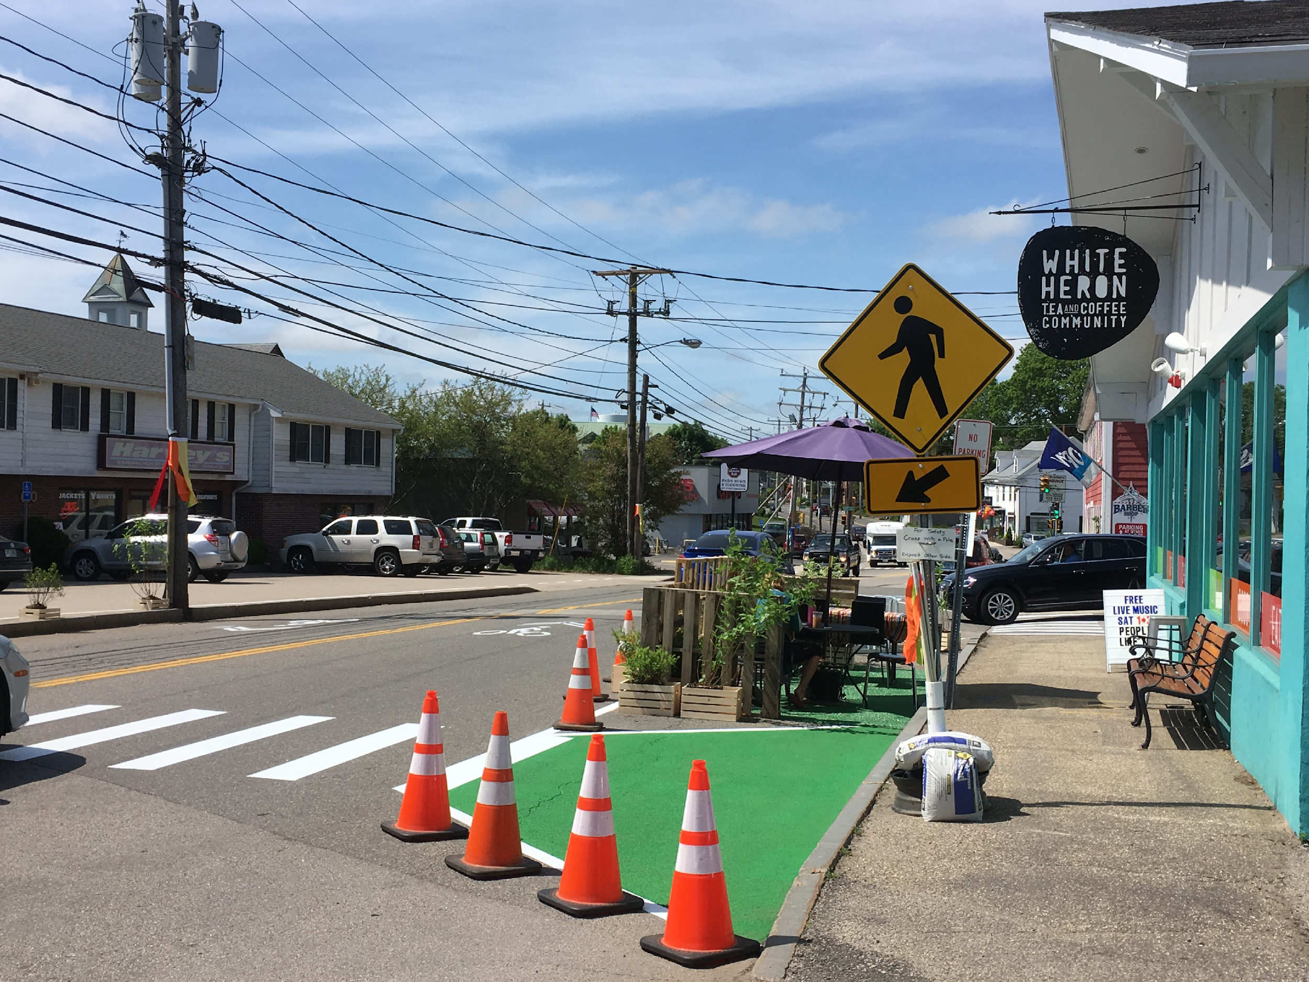
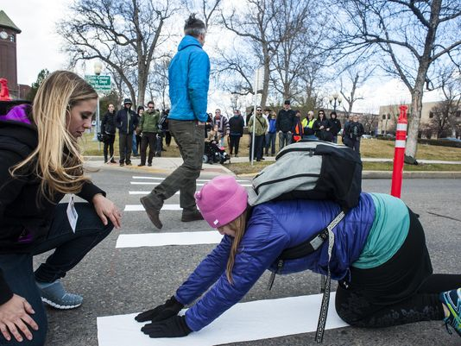
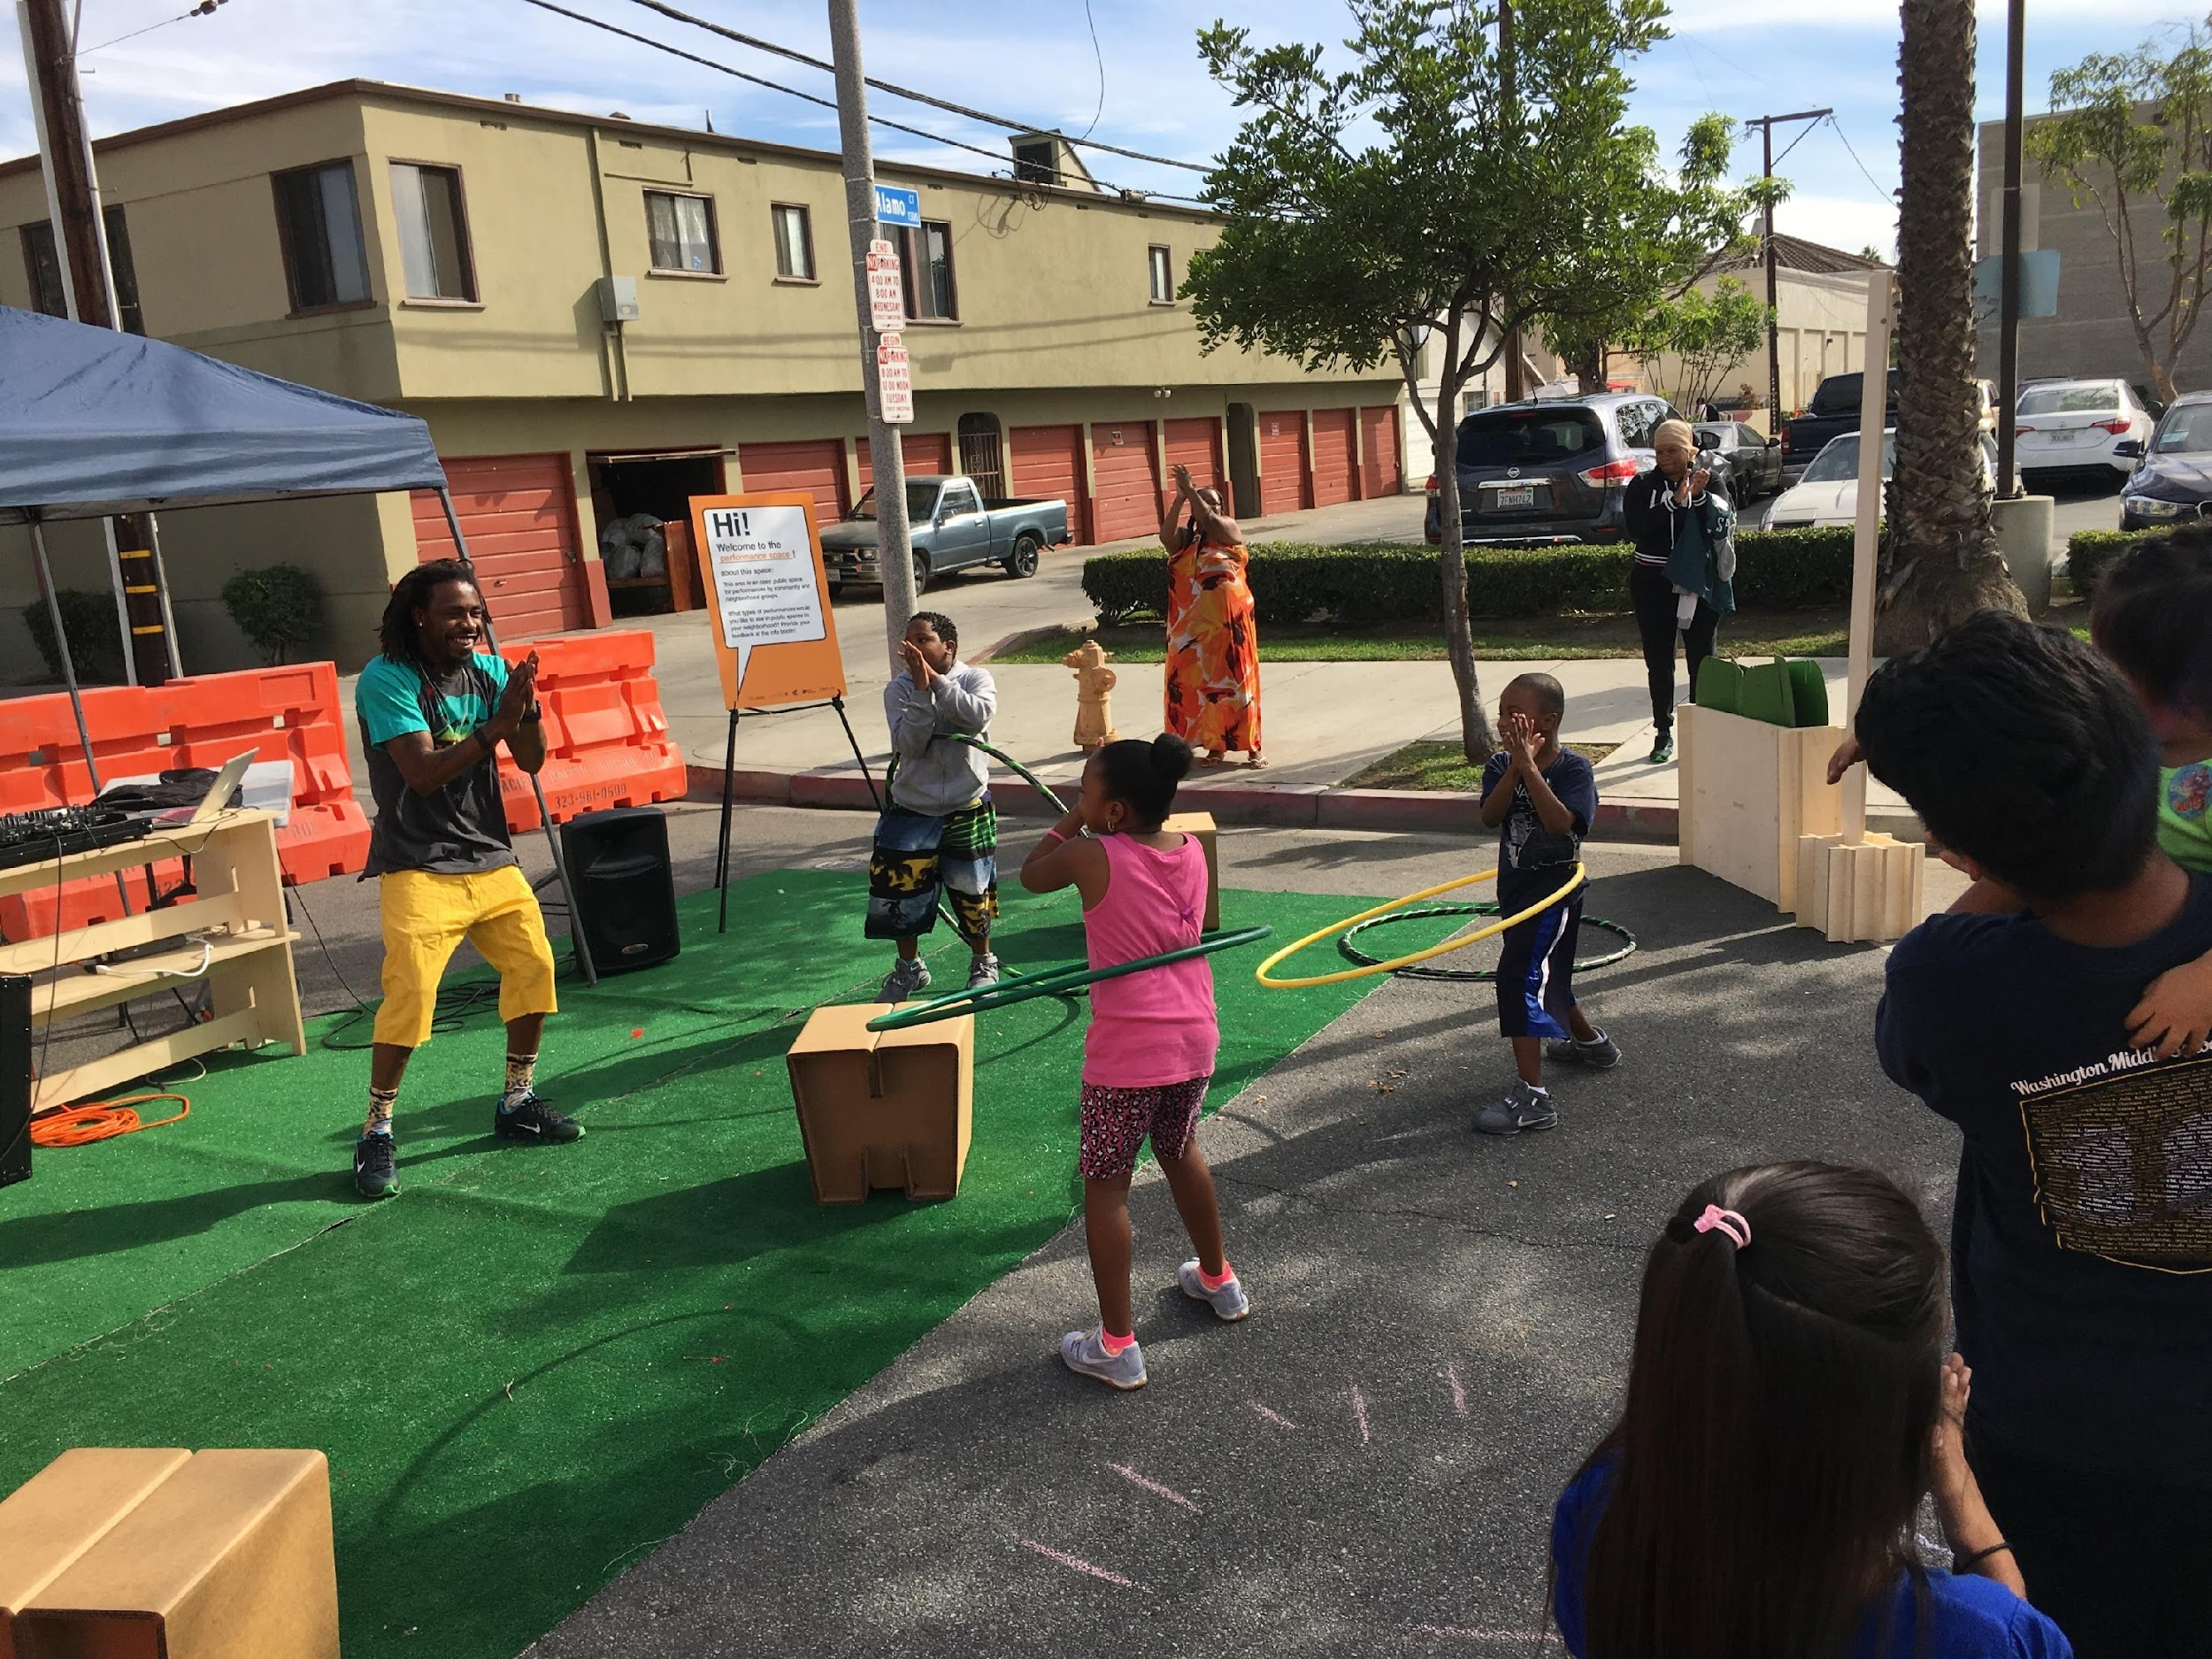
Why Tactical Urbanism?
Safety
Projects can help increase visibility of pedestrian and bicycle paths
Projects can alter driver behaviors, such as reducing speed and decreasing vehicle turning radius
Reclaiming Spaces
Projects can transform underutilized public spaces to provide new value to the community
Projects can bring public spaces to life with artwork
Fostering Community
Projects can grow a community’s connection with its infrastructure through collaboration on projects
Projects can create popular public areas that bond community members

Slide 5
Why Tactical Urbanism?
Studies show that implementing street art yields:
25%
Decrease in driver-pedestrian conflicts
Increase in drivers yielding to pedestrians
Decrease in car crashes involving pedestrians or cyclists
27%
50%
https://www.bloomberg.org/blog/new-study-shows-streets-are-safer-with-asphalt-art/

Slide 6
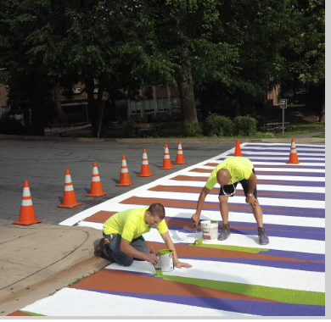
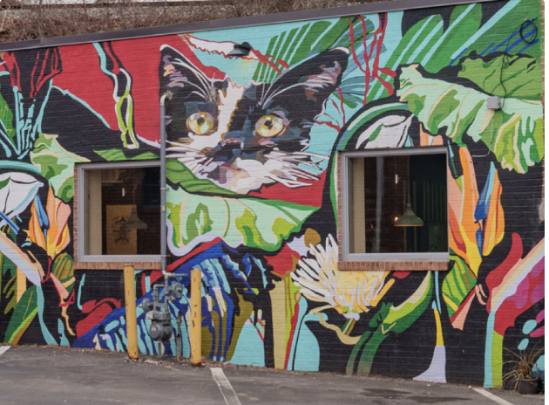
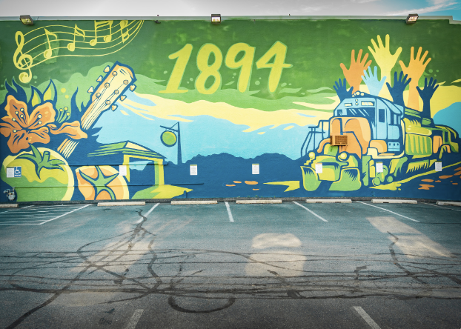
Public Art and Tactical Urbanism:
A Natural Fit for Kensington
Nearly 2 dozen commissioned works of art in public places throughout Town. Murals and carvings are located in parks and on buildings large and small. Tactical Urbanism art installations will add to the existing and vibrant art scene that is Kensington.
Tactical Urbanism employs many art techniques

Slide 7
Tactical Urbanism Tools
Barrier Elements
Flex posts
Cones
Concrete Barriers
Planters
Parking Blocks
Landscaping Elements:
Trees, plants
Astro turf, sod
Street furniture
Signage:
Information signs
Traffic signs
Path Signs
Surface Treatments:
Traffic Tape
Spray chalk
Stencils (Homemade/official)
Preformed thermoplastic
Paint:
corn starch
Temera
Acrylic asphalt
Pigment polymer cement
Street bond pavement coating
Epoxy Gravel

Slide 8
Site Safety Objectives
Reducing time in active roads:
Shortened crosswalk distances
Refuge islands
Slowing traffic:
Raised crosswalks
Narrow roads
Streetscapes
Speed limits
Speed enforcement
Increasing visibility:
Increased signage
New crosswalks
Reflective markers
Added light fixtures
Protection for pedestrians and bicyclists:
Separated bike lanes and sidewalks
Physical barriers to protect separation
Bump outs
Notes:
DO WE NEED THIS SLIDE? Suggest Deleting

Slide 9
A Public Art and Tactical Urbanism Pilot Project
Site Selection Process:
PBAS identified 8 potential sites from our Walkability Audit for consideration
3 sites selected as finalists based on potential impact
Key Project Components:
Ability to address existing safety shortfall
Community engagement and contribution
Opportunity to add Art to the Community

Slide 10
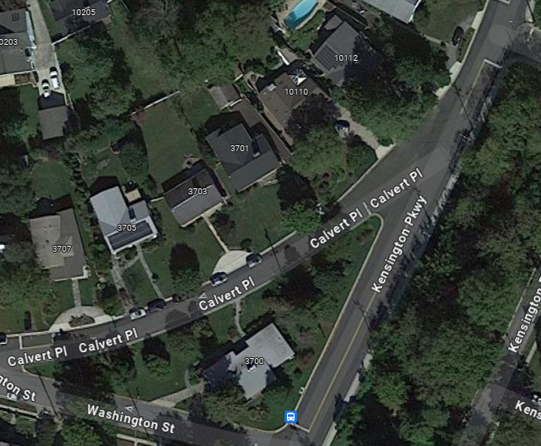
Site Option 1
Calvert Pl and Kensington Pkwy
Problem Statement: The wide angle of the turn from southbound Kensington Parkway going onto Calvert Place results in cars speeding
Opportunity: Slow the traffic turning on to Calvert Place and force better awareness onto drivers

Slide 11
Site Option 1
Calvert Pl and Kensington Pkwy
Recommendation: Use public art to reclaim part of Calvert Place and change the turn radius. This results in:
Drivers being required to slow down to make the turn on to Calvert Pl
Drivers are now more aware of their surroundings while making the turn
The reclaimed area is now safer for pedestrians
Example of this technique

Slide 12
Site Option 1
Calvert Pl and Kensington Pkwy
Implementation: The design would be a public art street installation that would carve away part of the intersection to create a sharper, more restricted turn from Kensington Pkwy on to Calvert Pl. It would consist of at least 2 separate installations to allow residents to access their driveways.
Materials: Paint, flex posts,
Cost estimate: $5,000-$7,000
Duration of installation: 6 Months
Analysis needed: Traffic engineer design review
Artist Selection: Local Artist
Community Engagement Strategy: Local Neighborhood, Calvert Pl Residences

Slide 13
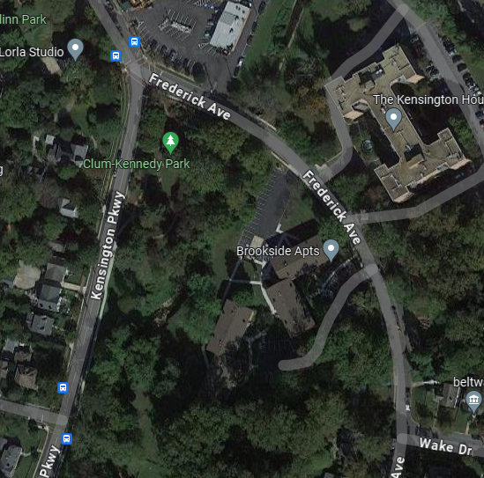
Site Option 2
Frederick Ave from Kensington Pkwy to Wake Dr
Problem Statement: The sidewalk on the North side of Frederick Ave does not extend East past The Kensington House, creating a dangerous path for pedestrians. This is particularly dangerous for children walking to Frederick Ave Neighborhood Park. This road is used by many commuters cutting through town during rush hour (despite the No Left Turn from Frederick Ave southbound onto Wake) and is very dangerous for pedestrians without a sidewalk.
Opportunity: Increase pedestrian visibility and safety across frequently traveled routes
Notes:
No sidewalk between apartments and playground on Frederick.

Slide 14
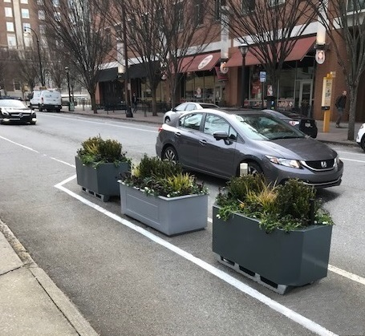
Site Option 2
Frederick Ave from Kensington Pkwy to Wake Dr
Recommendation: Use planters and other hard barriers to create a protected path on the shoulder of Frederick Ave. This results in:
A safe route for pedestrians and bicyclists
Increase driver awareness of pedestrians and bicyclists
Increase the streetscape’s greenery
Notes:
No sidewalk between apartments and playground on Frederick.

Slide 15
Site Option 2
Frederick Ave from Kensington Pkwy to Wake Dr
Implementation: The design would use planters or other hard barriers to create a safe lane for pedestrians and bicyclists on the North side of Frederick. Flex posts and reflective tape can be used to increased visibility. A bike rack will be added to the park’s parking lot. A crosswalk will be added going across Frederick Ave connecting the sidewalk on the south side to the park.
Materials: Planters, Paint, Reflective tape, Flexposts, Bike rack
Cost estimate: $15,000 - $20,000
Duration of installation: 6-12 months
Analysis needed: Traffic Engineer Design Review
Artist Selection: Local Artists
Community Engagement Strategy: Local Neighborhood, Local Apartments
Notes:
No sidewalk between apartments and playground on Frederick.
Could Save $1k on flowers by using the planters as community gardens.

Slide 16
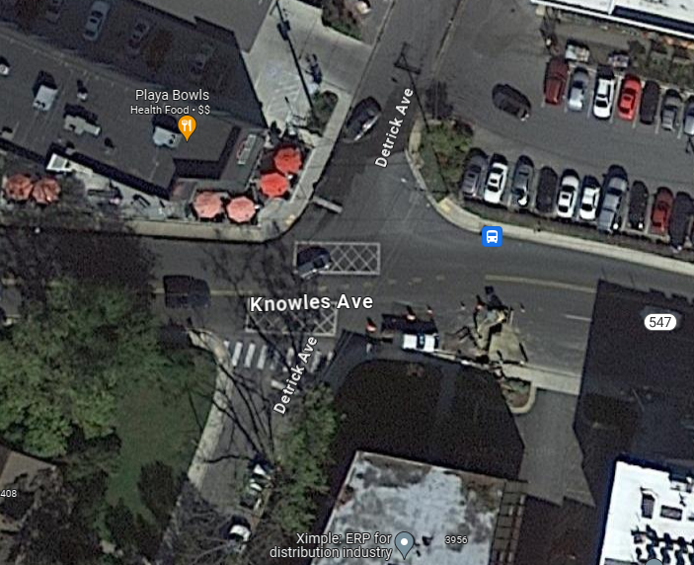
Site Option 3
Knowles Ave & Detrick Ave
Problem Statement: This section of town is rapidly developing and increasing pedestrian traffic. The lack of crosswalks across Knowles Ave/and Detrick Ave create a difficult intersection for pedestrians and bicyclists.
Opportunity: Increase pedestrian visibility and safety across frequently traveled routes
Notes:
No crosswalk across Detrick between Strosnider's shopping center and Wine & Co
Shared jurisdiction with county

Slide 17
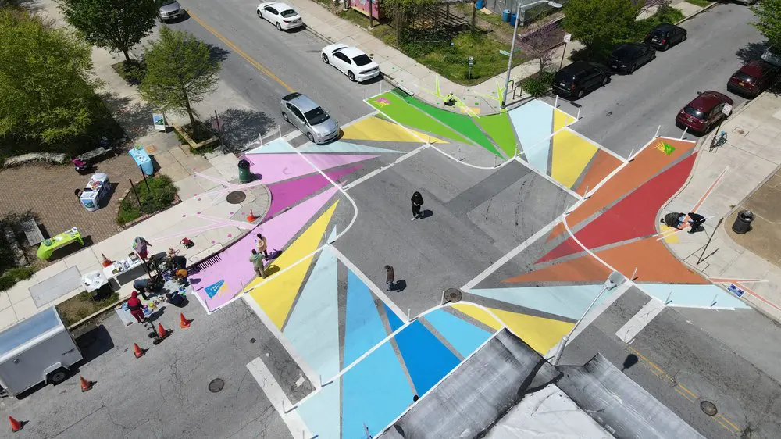
Site Option 3
Knowles Ave & Detrick Ave
Recommendation: Use public art to create crosswalks and bump outs on Knowles and Detrick. This results in:
Drivers pressured to drive slower through intersections
Sharper turn forces drivers to drive slower when turning on to Detrick Ave Northbound from Knowles going west bound
Drivers are now more aware of pedestrian crossings
The reclaimed area is now safer for pedestrians
Example of this technique

Slide 18
Site Option 3
Knowles Ave & Detrick Ave
Implementation: The design would include a public art street reclamation/large bump-out on the northeast corner. Bump-outs would be added on the remaining three corners. Lastly it would create a crosswalk on the western side across Knowles and a crosswalk across the northern side across Detrick. Possible bike rack added to the shopping center parking lots.
Materials: Paint, flex posts, reflective tape, signage, Bike rack
Cost estimate: $15,000-$20,000
Duration of installation: 6 months
Analysis needed: Traffic Engineer Design Review, SHA Coordination,
Artist selection: Local Artists
Community Engagement: Local Neighborhoods, Businesses, Neighborhood Associations
Notes:
No crosswalk across Detrick between Strosnider's shopping center and Wine & Co
Shared jurisdiction with county

Slide 19
Next Steps
Respond to Action items
Engagement and Project Plan Development
Engage Art Community
Student SSL Project?
Community input
Site Design
Site Review
Vendors and material acquisition
Labor plan
Implementation
Evaluation
Removal

Slide 20
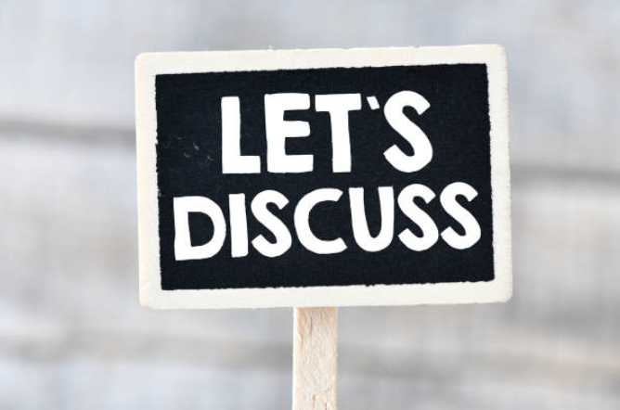
Discussion
?

